Slide 1
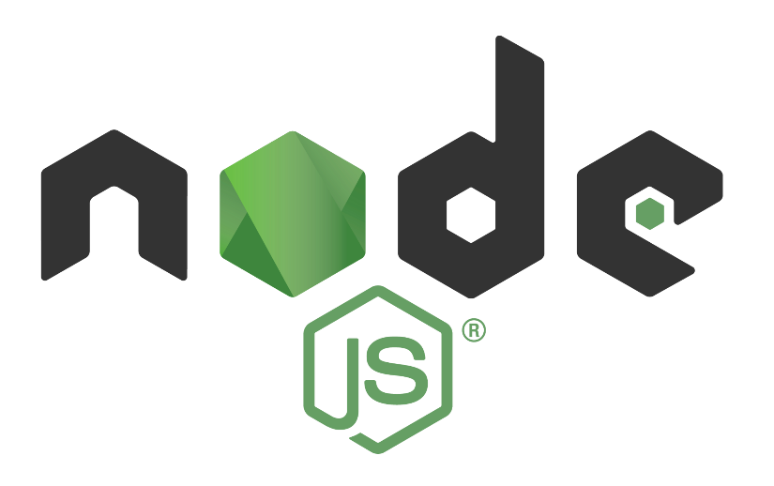
Application Delivery Fundamentals
Parameswari Ettiappan

Slide 2
Goals
Node.js basics
Introduction to Google V8
LibVU
Node.js Single Threading
process.tick
Architecture
Introduction to npm
npm Init
Installing npm Packages
Dependency Management
Development Dependency

Slide 3
Goals
npm Scripts
Global Modules vs Local modules
Creating Node.js projects
Package file, “main” file, index.js files
Importing & reusing node.js modules in various projects
Version management of Node modules
HTTP

Slide 4
Goals
The HTTP protocol
Building an HTTP server
Rendering a response
Processing query strings
Using Representational State Transfer
Configuring TLS

Slide 5
Goals
File System
Synchronous vs. asynchronous I/O
Path and directory operations
__dirname and __filename
Asynchronous file reads and writes
Buffers, Streams, and Events
Using buffers for binary data
Flowing vs. non-flowing streams
Streaming I/O from files and other sources
Processing streams asynchronously
Configuring event handlers

Slide 6
Goals
Introduction to JavaScript Scope Issues
Introduction to Common JS
Modules, Module Scoping
CommonJS ‘require’ and “module.exports”
Important of CommonJS in JavaScript Application
Why CommonJS for React.js or Modern day web app development
Module Default Exports

Slide 7
Javascript Lifecycle
js file (source code) ➝ compiled into machine code (based on the CPU it runs)
The system that compiles the javascript files into machine code and also manage the program's memory is called javascript runtime.
Chrome V8 engine originally ran in Chrome web browsers.
But later it was used to run the javascript without a browser and that exactly what Node.js is.
Node.js is written in C++ and build on top of the Chrome V8 engine which is also written in C++. V8 provides the runtime for the Javascript.

Slide 8
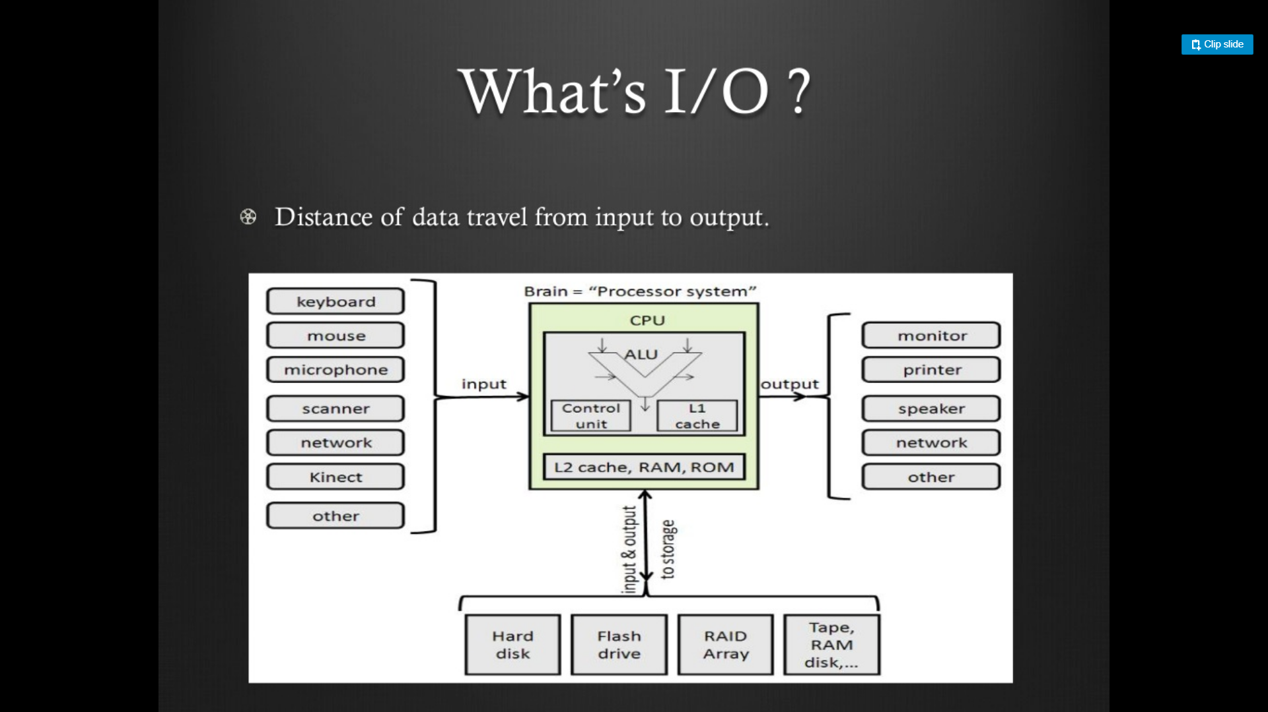

Slide 9


Slide 10
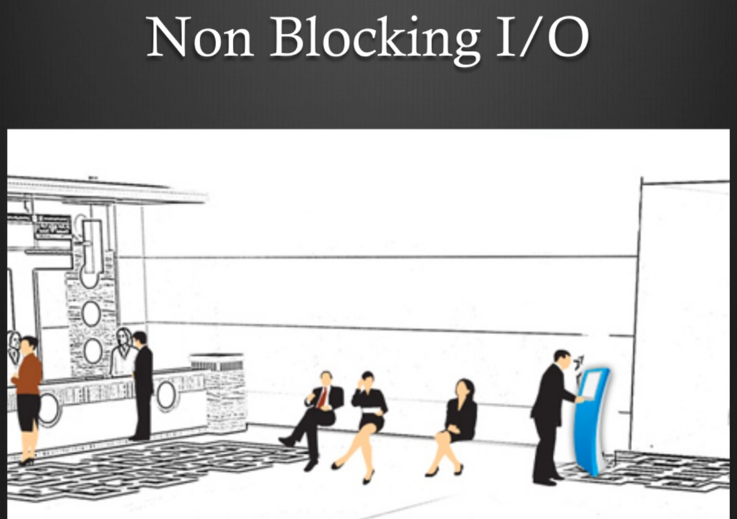

Slide 11
How is Javascript compiled and Run?
Javascript Program (source code) ➝ Chome V8 Engine (compiles) ➝ Machine Code (X86_64, MIPS, ARM, etc) ➝ Runs on CPU.
Different CPU architecture requires different machine code based on its architecture.
So, the program needs to be converted into the machine code that it can understand.
Javascript program is compiled and the bytecode (machine code) is optimized and finally, the machine code runs on the CPU.
All these operations are performed by the V8.

Slide 12
What is Node.js?
Node.js is an open-source server side runtime environment built on Chrome's V8 JavaScript engine.
It provides an event driven, non-blocking (asynchronous) I/O and cross-platform runtime environment for building highly scalable server-side application using JavaScript.
Node.js can be used to build different types of applications such as command line application, web application, real-time chat application, REST API server etc.

Slide 13
What is Node.js?
However, it is mainly used to build network programs like web servers, similar to PHP, Java, or ASP.NET.
Node.js was written and introduced by Ryan Dahl in 2009.

Slide 14
Main Building Blocks
V8 — a Google’s open source high-performance JavaScript engine, written in C++. It is also used in Google Chrome browser and others. Node.js controls V8 via V8 C++ API.
libuv — a multi-platform support library with a focus on asynchronous I/O, written in C. It was primarily developed for use by Node.js, but it’s also used by Luvit, t, Julia, pyuv, and others.

Slide 15
Main Building Blocks
. Node.js uses libuv to abstract non-blocking I/O operations to a unified interface across all supported platforms.
This library provides mechanisms to handle file system, DNS, network, child processes, pipes, signal handling, polling and streaming.
It also includes a thread pool, also known as Worker Pool, for offloading work for some things that cannot be done asynchronously at the OS level.

Slide 16
Main Building Blocks
Other open-source, low-level components, mostly written in C/C++:
- c-ares — a C library for asynchronous DNS requests, which is used for some DNS requests in Node.js.
- http-parser — a lightweight HTTP request/response parser library.
- OpenSSL — a well-known general-purpose cryptography library. Used in tls and crypto modules.
- zlib — a lossless data-compression library. Used in zlib module.

Slide 17
Main Building Blocks
The application — it’s your application’s code and standard Node.js modules, written in JavaScript.
C/C++ bindings — wrappers around C/C++ libraries, built with N-API, a C API for building native Node.js addons, or other APIs for bindings..

Slide 18
Main Building Blocks
Some bundled tools that are used in Node.js infrastructure:
- npm — a well-known package manager (and ecosystem).
- gyp — a python-based project generator copied from V8. Used by node-gyp, a cross-platform command-line tool written in Node.js for compiling native addon modules.
- gtest — Google’s C++ test framework. Used for testing native code.

Slide 19
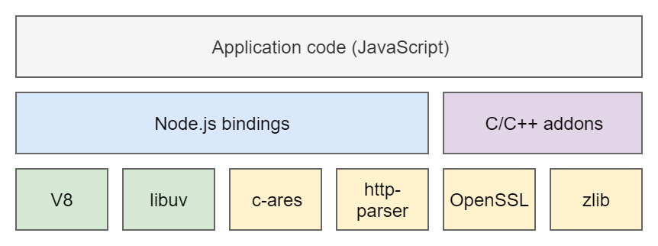
Main Node.js components

Slide 20
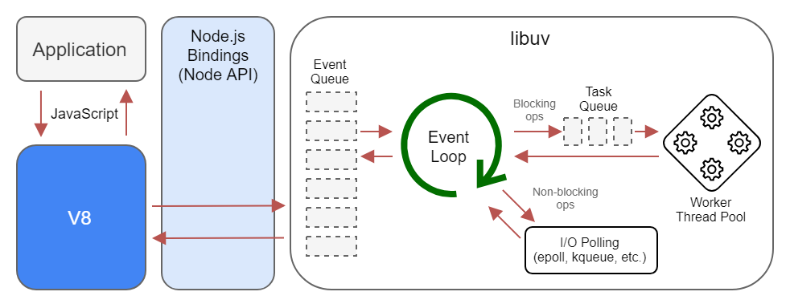
Node.js Runtime

Slide 21
Introduction to Google V8
V8 is Google’s open source high-performance JavaScript and WebAssembly engine, written in C++
V8 Does:
Compiles and executes JS code
Handling call stack — running your JS functions in some order
Managing memory allocation for objects — the memory heap
Garbage collection — of objects which are no longer in use
Provide all the data types, operators, objects and functions

Slide 22
Introduction to Google V8
V8 Can:
Provide the event loop, but this is sometimes implemented by the browser as well
V8 Doesn’t:
Know anything about the Document Object Model (DOM) — which is provided by the browser, and obviously irrelevant to Node.js for example

Slide 23
Introduction to Google V8
V8 is a single threaded execution engine.
It’s built to run exactly one thread per JavaScript execution context.
You can actually run two V8 engines in the same process — e.g. web-workers, but they won’t share any variables or context like real threads.
On the runtime, V8 is mainly managing the heap memory allocation and the single threaded call stack.
The call stack is mainly a list of function to execute, by calling order.

Slide 24
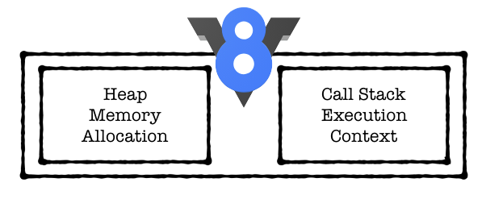
Introduction to Google V8
Every function which calls another function will be inserted one after the other directly, and callbacks will be sent to the end.
This is actually why calling a function with setTimeout of zero milliseconds sends it to the end of the current line and doesn’t call it straight away (0 milliseconds).

Slide 25

V8 Key Components
JS Interpreter — Ignition & Optimization Compiler — TurboFan & Crankshaft.
V8 gets its speed from just-in-time (JIT) compilation of JavaScript to native machine code, just before executing it.
First of all, the code is compiled by a baseline compiler, which quickly generates non-optimized machine code.
On runtime, the compiled code is analyzed and can be re-compiled for optimal performance.
Ignition provides the first while TruboFan & Crankshaft the second.

Slide 26
V8 Key Components
JIT compilation result machine code can take a large amount of memory, while it might be executed once.
This is solved by the Ignition, which is executing code with less memory overhead.
The TurboFan project started in 2013 to improve the weakness of Crankshaft which isn't optimized for some part of the JavaScript functionality e.g. error handling.
It was designed for optimizing both existing and future planned features at the time.

Slide 27
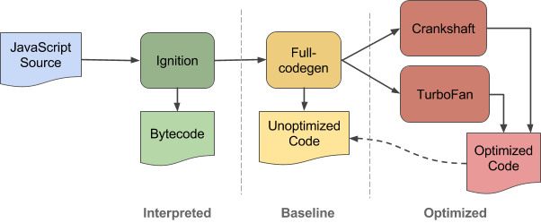
V8 Key Components

Slide 28
WebAssembly — Liftoff
Achieving great performance is also key in the browser, and this is the task Liftoff is used for — generating machine code.
Not using the complex multi-tier compilation, Liftoff is a simpler code generator, which generates code for each opcode (a single portion of machine code, specifying an operation to be performed) at a time.
Liftoff generates code much faster than TurboFan (~10x) which is obviously less performant (~50%).

Slide 29

WebAssembly — Liftoff
Achieving great performance is also key in the browser, and this is the task Liftoff is used for — generating machine code.
Not using the complex multi-tier compilation, Liftoff is a simpler code generator, which generates code for each opcode (a single portion of machine code, specifying an operation to be performed) at a time.
Liftoff generates code much faster than TurboFan (~10x) which is obviously less performant (~50%).

Slide 30
Garbage Collection — Orinoco
Running over the memory heap, looking for disconnected memory allocations is the Orinoco.
Implementing a generational garbage collector, moving objects within the young generation, from the young to the old generation, and within the old generation.
These moves leave holes, and Orinoco performs both evacuation and compaction to free space for more objects.

Slide 31

Garbage Collection — Orinoco
Another optimization performed by Orinoco is in the way it searches through the heap to find all pointers that contain the old location of the objects moved and update them with the new location.
This is made using a data structure called remembered set.
On top of these, black allocation is added, which basically means the garbage collection process automatically marks living objects in black in order to speed up the iterative marking process..

Slide 32
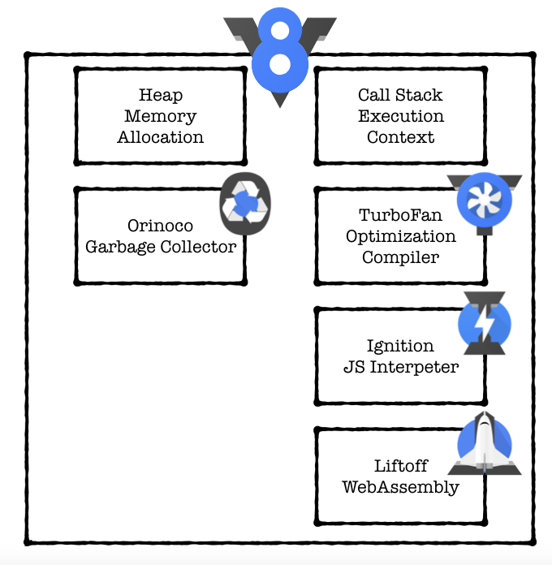

Slide 33
Traditional Web Server Model
In the traditional web server model, each request is handled by a dedicated thread from the thread pool.
If no thread is available in the thread pool at any point of time then the request waits till the next available thread.
Dedicated thread executes a particular request and does not return to thread pool until it completes the execution and returns a response.

Slide 34
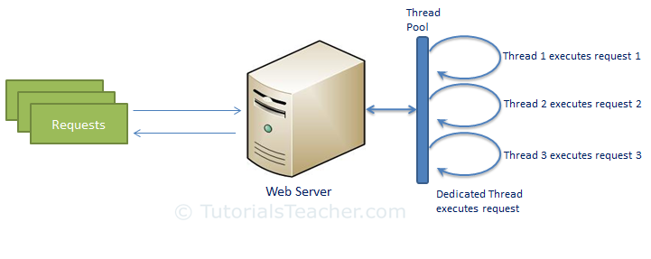
Traditional Web Server Model

Slide 35
Node.js Process Model
Node.js processes user requests differently when compared to a traditional web server model.
Node.js runs in a single process and the application code runs in a single thread and thereby needs less resources than other platforms.
All the user requests to your web application will be handled by a single thread and all the I/O work or long running job is performed asynchronously for a particular request.
So, this single thread doesn't have to wait for the request to complete and is free to handle the next request.
When asynchronous I/O work completes then it processes the request further and sends the response.

Slide 36
Node.js Process Model
An event loop is constantly watching for the events to be raised for an asynchronous job and executing callback function when the job completes.
Internally, Node.js uses libev for the event loop which in turn uses internal C++ thread pool to provide asynchronous I/O..

Slide 37
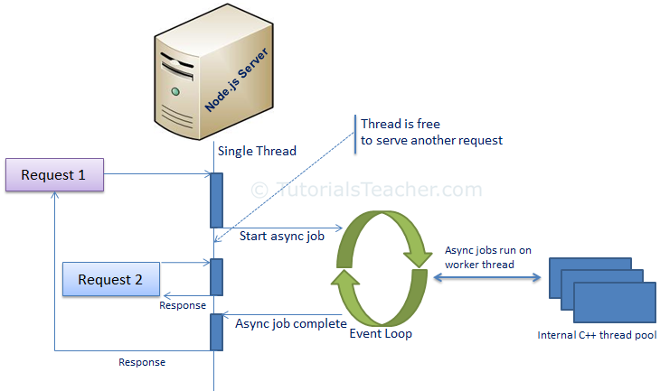

Slide 38
Nodejs Process Model
Node.js process model increases the performance and scalability with a few caveats.
Node.js is not fit for an application which performs CPU-intensive operations like image processing or other heavy computation work because it takes time to process a request and thereby blocks the single thread.

Slide 39
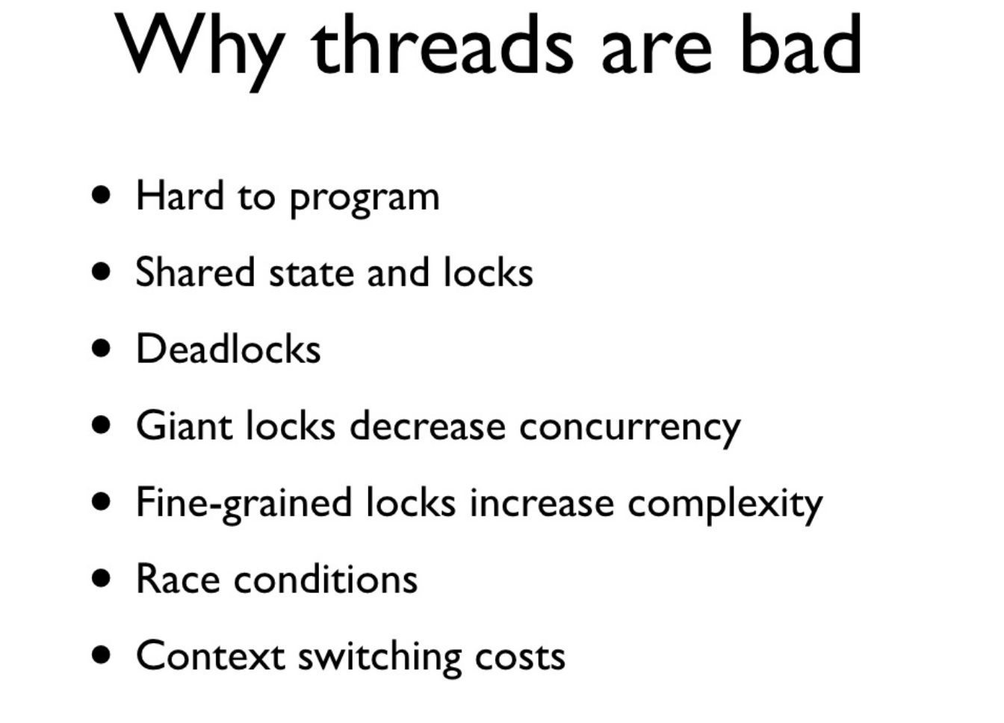

Slide 40
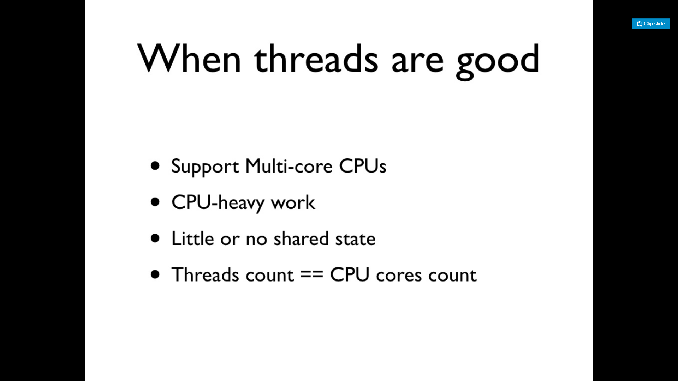

Slide 41
Node JS Architecture – Single Threaded Event Loop
Node JS Platform does not follow Request/Response Multi-Threaded Stateless Model.
It follows Single Threaded with Event Loop Model. Node JS Processing model mainly based on Javascript Event based model with Javascript callback mechanism.

Slide 42
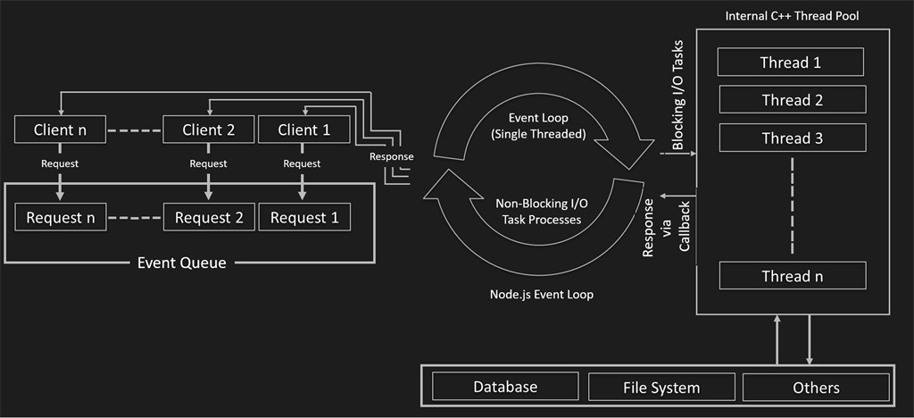
Node.js Single Threading

Slide 43
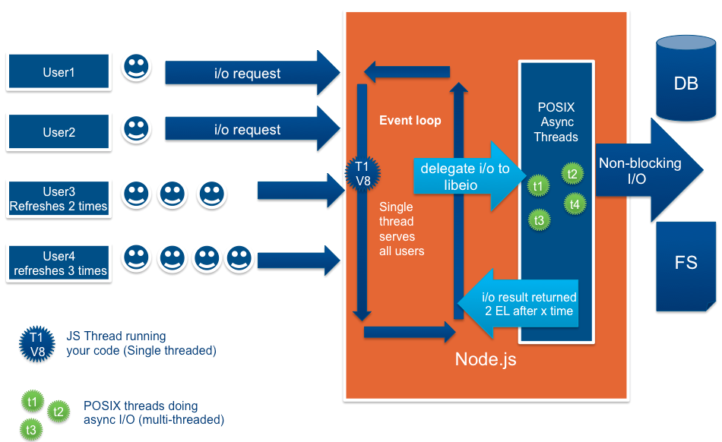

Slide 44
Single Threaded Event Loop Model Processing Steps:
Clients Send request to Web Server.
Node JS Web Server internally maintains a Limited Thread pool to provide services to the Client Requests.
Node JS Web Server receives those requests and places them into a Queue. It is known as “Event Queue”.
Node JS Web Server internally has a Component, known as “Event Loop”. Why it got this name is that it uses indefinite loop to receive requests and process them

Slide 45
Single Threaded Event Loop Model Processing Steps:
Event Loop uses Single Thread only. It is main heart of Node JS Platform Processing Model.
Even Loop checks any Client Request is placed in Event Queue. If no, then wait for incoming requests for indefinitely.

Slide 46
Single Threaded Event Loop Model Processing Steps:
If yes, then pick up one Client Request from Event Queue
Starts process that Client Request
If that Client Request Does Not requires any Blocking IO Operations, then process everything, prepare response and send it back to client.
If that Client Request requires some Blocking IO Operations like interacting with Database, File System, External Services then it will follow different approach
Checks Threads availability from Internal Thread Pool
Picks up one Thread and assign this Client Request to that thread.
That Thread is responsible for taking that request, process it, perform Blocking IO operations, prepare response and send it back to the Event Loop
Event Loop in turn, sends that Response to the respective Client.

Slide 47
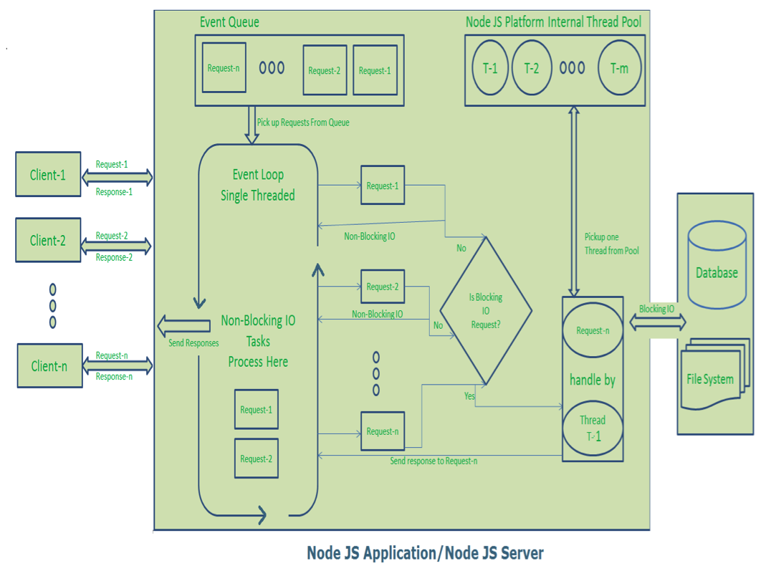

Slide 48
Node JS Architecture – Single Threaded Event Loop Advantages
Handling more and more concurrent client’s request is very easy.
Even though our Node JS Application receives more and more Concurrent client requests, there is no need of creating more and more threads, because of Event loop.
Node JS application uses less Threads so that it can utilize only less resources or memory

Slide 49
Features of Node JS
Modularity
Major advantage of Node JS Platform is that it’s modularity.
Each and every functionality is divided and implemented as a separate module or package.
When we install Node JS Platform, by default it installs only few modules.
If our application requires other modules, then we can easily install and configure then at any point of our application development phases.

Slide 50
Features of Node JS
Node JS has thousands of thousands modules. Some modules were developed by Node JS Community and some were by Third-party Clients.

Slide 51
Features of Node JS
Express JS
Node JS is used to develop Server-side Java Script. It also contains a separate module for Web Application Framework i.e. Express JS.
Non-blocking or Asynchronous IO
Node JS supports Non-blocking IO i.e. it uses Asynchronous IO Model to interact with File system or to do Socket communication or network communication.
Asynchronous IO Model means if IO processing is taking more time, then it permits other processing to continue before the transmission has finished.

Slide 52
Features of Node JS
Java Developers are very much familiar about Blocking IO and Non-Blocking IO.
Java IO package follows Blocking IO or Synchronous IO Architecture whereas Java NIO 2 follows Non-Blocking IO or Asynchronous IO Architecture..

Slide 53
Features of Node JS
Java Developers are very much familiar about Blocking IO and Non-Blocking IO.
Java IO package follows Blocking IO or Synchronous IO Architecture whereas Java NIO 2 follows Non-Blocking IO or Asynchronous IO Architecture.
Event-Driven Asynchronous Platform
Node JS Platform follows Even-Driven Loop architecture to interact or handle requests.

Slide 54
Features of Node JS
MongoDB Wrappers API
Node JS platform contains a separate module to integrate MongoDB No SQL database with applications. It provides a MongoDB wrapper API.
We can use this API to write JavaScript easily to interact with MongoDB database. Node JS-mongodb module uses Mongoose to interact with MongoDB database.

Slide 55
Features of Node JS
Redis Client Library APINode JS platform contains a separate module to integrate Redis No SQL database with applications.
It provides a Redis wrapper API. We can use this API to write JavaScript easily to interact with Redis database.

Slide 56
Features of Node JS
Jade Template Engine
Node JS platform supports many template engines to write HTML. Default template engine supported by Node JS is “Jade”.
Jade is a whitespace-sensitive template engine for developing HTML applications very easily.
We can write template pages once and reuse them very easily to reduce development time. We will discuss how to install and write Jade templates in a separate post.

Slide 57
Features of Node JS
Web Server
We can develop and use HTTP Web Server within no time. We need to use http package to implement Web Server. We will discuss one post on how to install http package and develop a Web Server.
Better Socket API
Node JS Platform provides very good Socket Module API to develop Real-time, Multi-User Chat and Multi-Player Gaming Applications very easily. It supports Unix Socket programming like pipe().

Slide 58
Advantages of Node JS
One Language and One Data Format
Open Source
Highly Scalable
Better Performance and Low Latency
Caching Modules
Less Problems with Concurrency
Easy to Extend and Lightweight
Faster Development and Easy to Maintain

Slide 59
Advantages of Node JS
REST API
Active Development Community
Unit Testing
Streaming Data
Creating Servers
It can handle thousands of concurrent connections with minimal overhead (CPU/Memory) on a single process
Easy Module Loading process

Slide 60
Who uses Node JS Platform
DOW JONES
When-To-Manage
Linkedin
MicroSoft
Twelephone (It is a service for making calls right from Twitter account)
Yahoo
PayPal
eBay
STRONGLoop
Wallmart
Groupon
SAP
PINT Web Platform (PWP)
Cloud9 IDE
Dropbox
ZingChart
Chess (It is an online game available on facebook.com)

Slide 61
Node JS Applications
Network applications
Asynchronous Events
Intelligent Networking Proxies
Proxy Server
Multiplayer Game Applications
Data Intensive Real-time applications
Web Applications
High Definition(HD) Voice and Video Communications
File Uploading Tools
Process Monitoring Tools
Many-To-Many Instant Chatting Applications
Many-To-Many Instant Messing Applications
HTTP Web Server
Real-time Logistics Systems
Streaming Server
High Concurrency Applications
Communication Hubs
Coordinators
DNS Server
Static File Server
TCP Server
Stock-Trading Dashboard

Slide 62
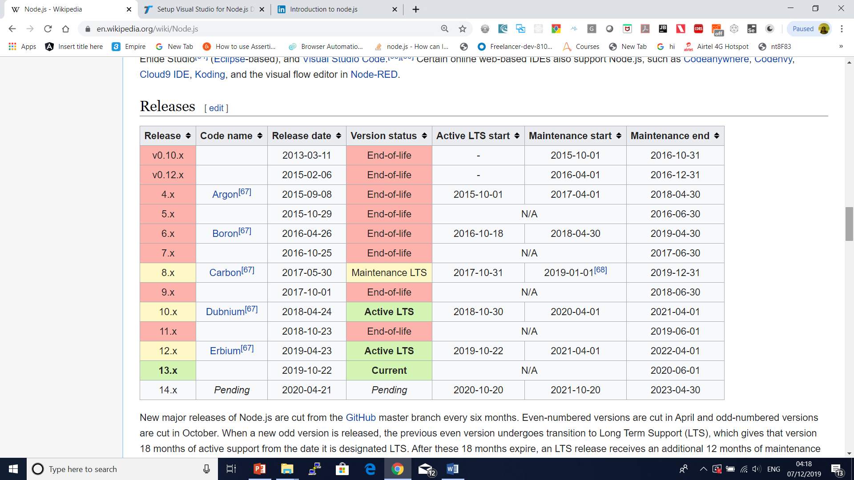
Nodejs Versions

Slide 63
CommonJS

Slide 64
Questions

